Slide 1
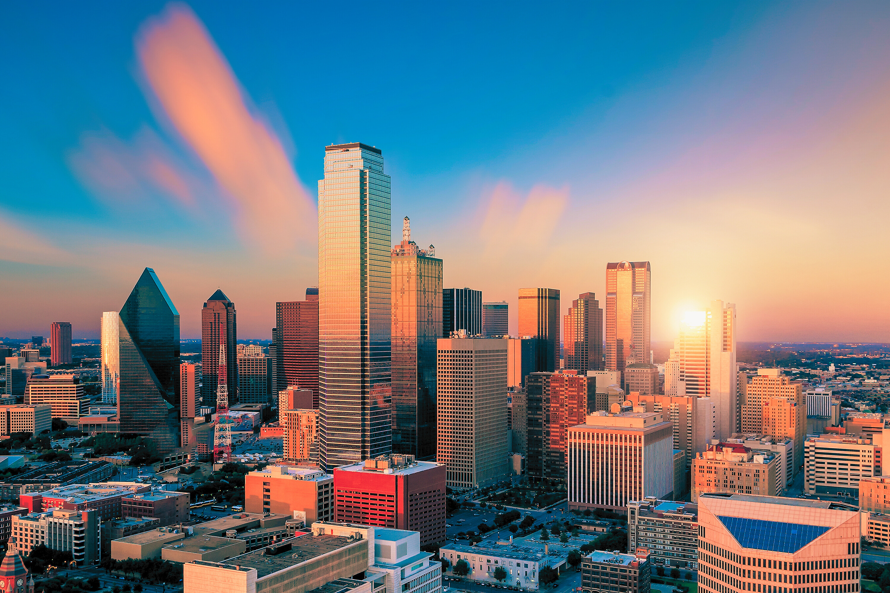



ANNUAL MEETING
September 11-14, 2025 | Dallas, TX

Slide 2


Slide 3
HEADER
Content

Slide 4
HEADER
HEADER
VISION
Content here
Content here

Slide 5
01
Content here
02
Content here
HEADER
03
Content here

Slide 6

THANK YOU

